Slide 1
Is future transport here?
Comparing EV efficiency to ICE vehicles
Group 6: Julian Pecino, Jeremy Del Moral, Elijah Montgomery, Joshna Rence

Slide 2
Questions to be Answered:
Budget
Is an EV affordable for a median income earning family household in the US?
EV as Commercial Vehicle
Is an EV appropriate for commercial applications including cross country transport?
Affordability
Cost comparison over a 5-year span for Tesla Model 3 and Toyota Corolla.

Slide 3
Budget
Question 1: Is an EV affordable for a median income earning family household in the US?

Slide 4
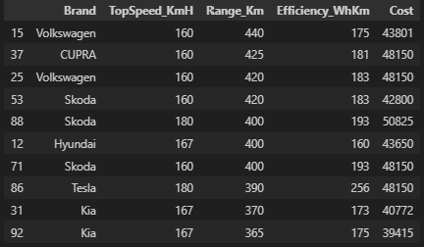
EV cost Dataset

Slide 5
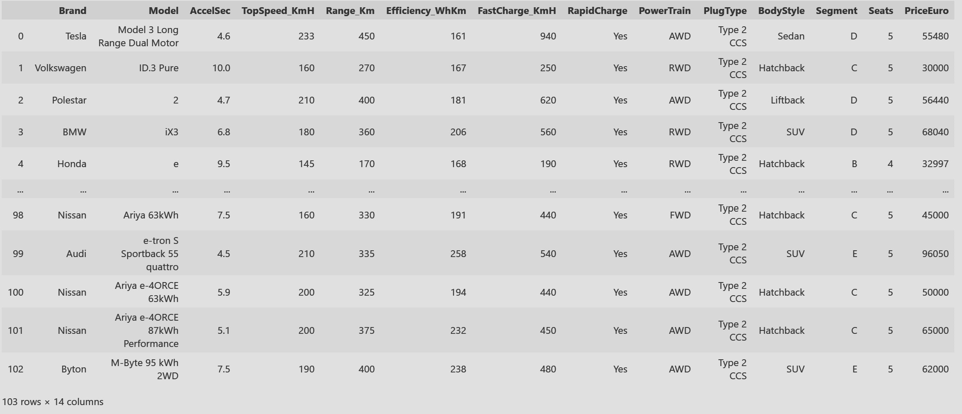
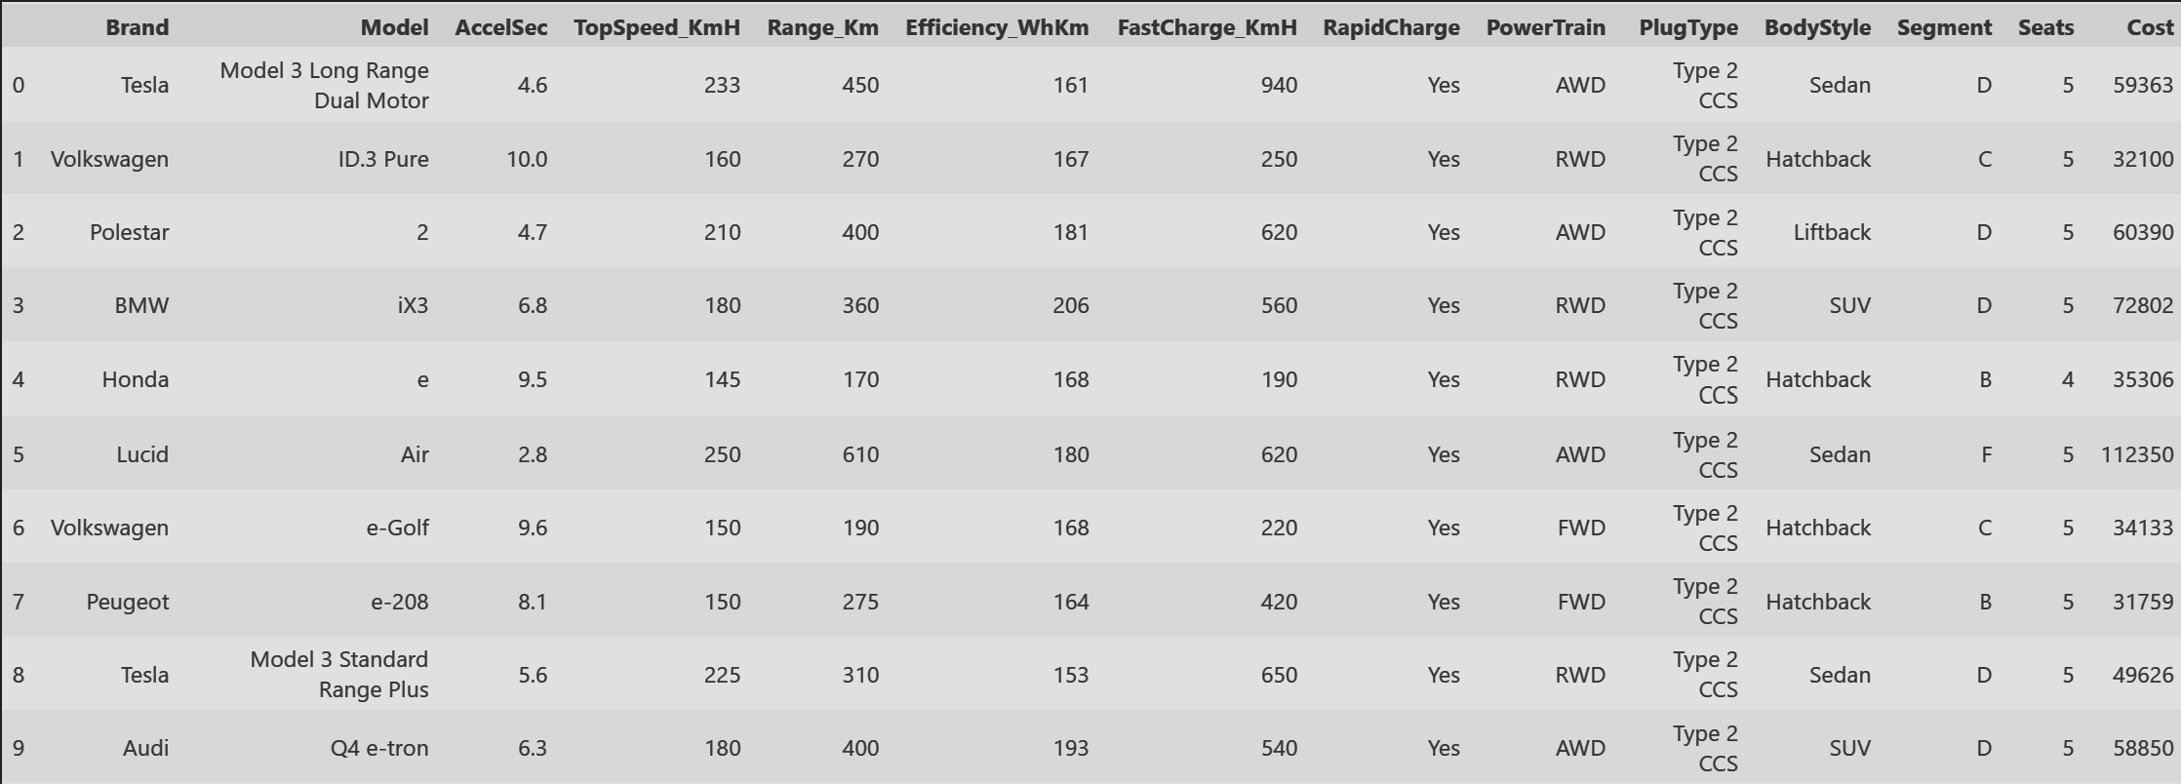
Electric vehicle dataset
Data Cleaned up:
Conversion of cost from Euro to US Dollars.

Slide 6
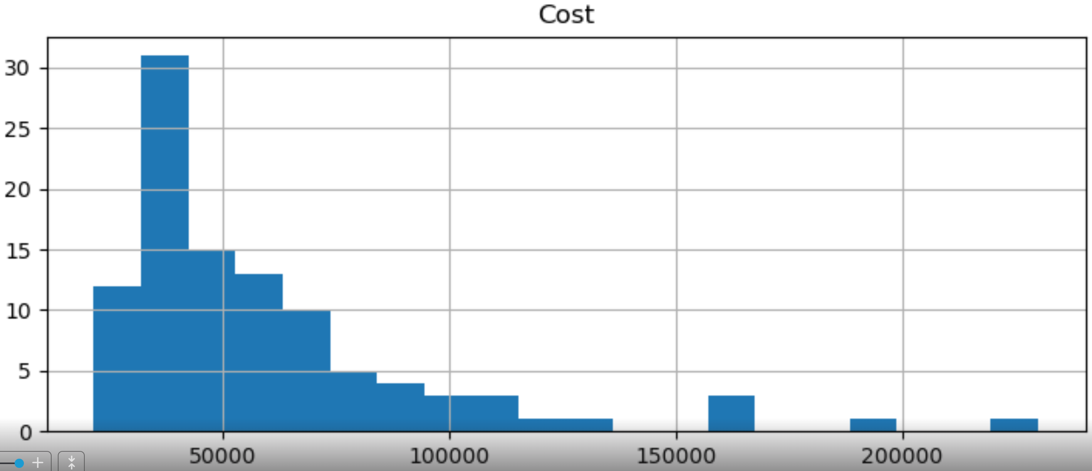
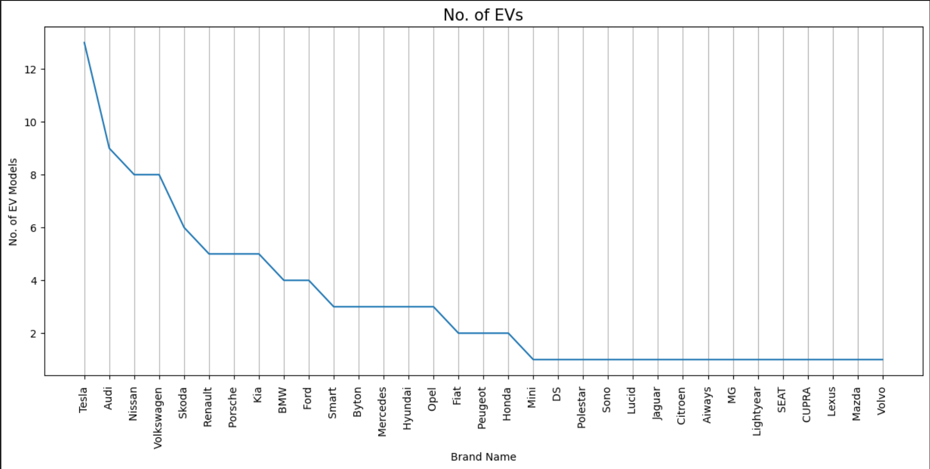
Electric vehicle Models
From a first order analysis, it is evident that there are around ~30 EV options less than $50k price range.
The graph shows the number of Electric Vehicle models per car manufacturing companies with Tesla leading the chart.

Slide 7

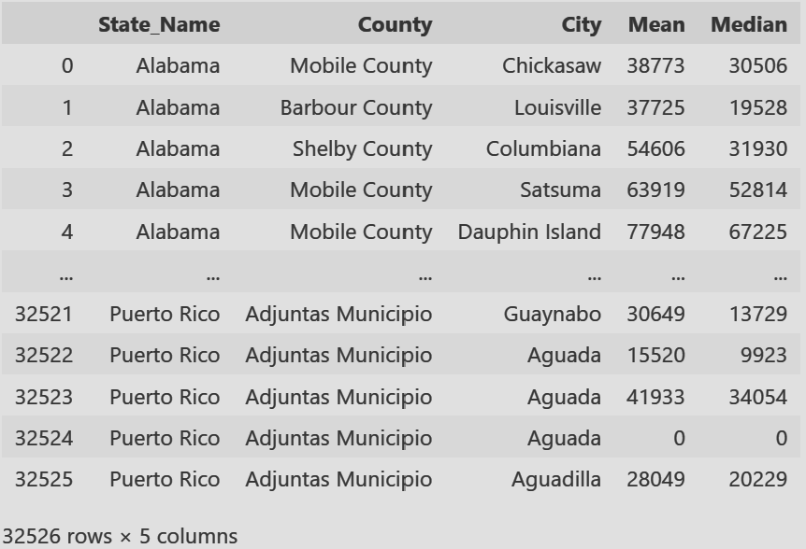
US MEDIAn income details

Slide 8
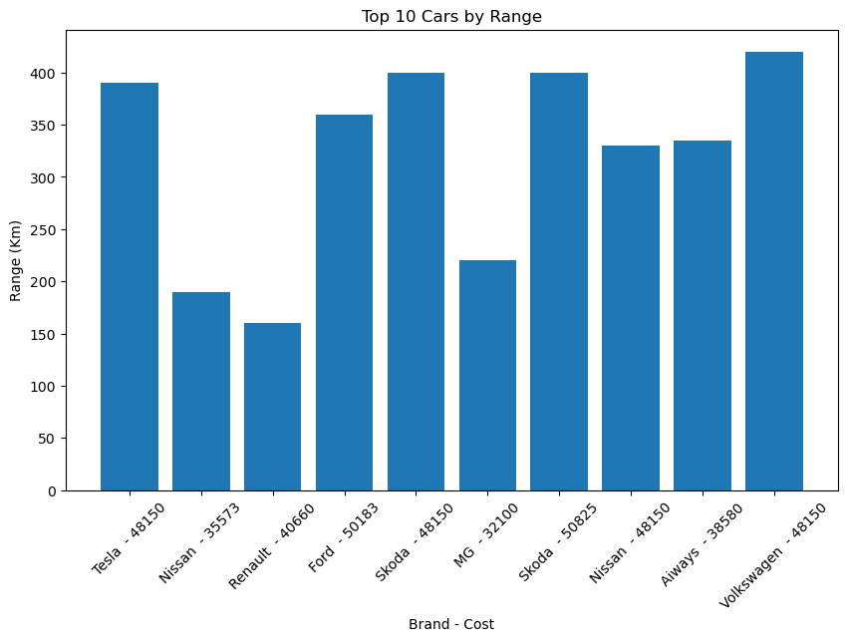
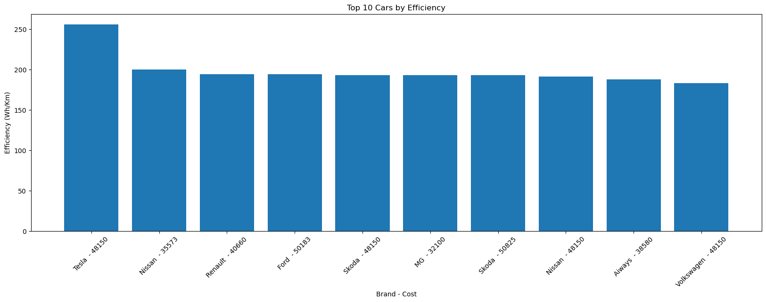
Ranking electric vehicles
According to a survey on median income across US cities, it is evident that electric vehicles (EVs) could be reasonably affordable for most households.
The top 10 cars are ranked based on their range and efficiency, making them potential options to consider for this budget.
The answer is Yes! It’s very possible to afford an EV on the median income of the U.S. and there are plenty of options to select from!

Slide 9
EV as Commercial Vehicle
Question 2: Is an EV appropriate for commercial applications including cross country transport?

Slide 10

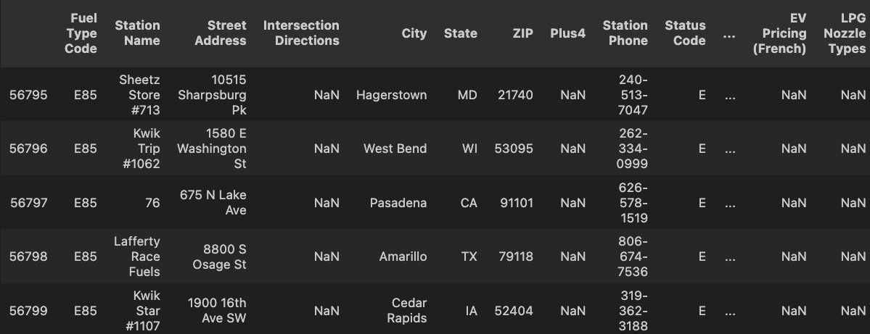

Fuel type &charging station dataset

Slide 11
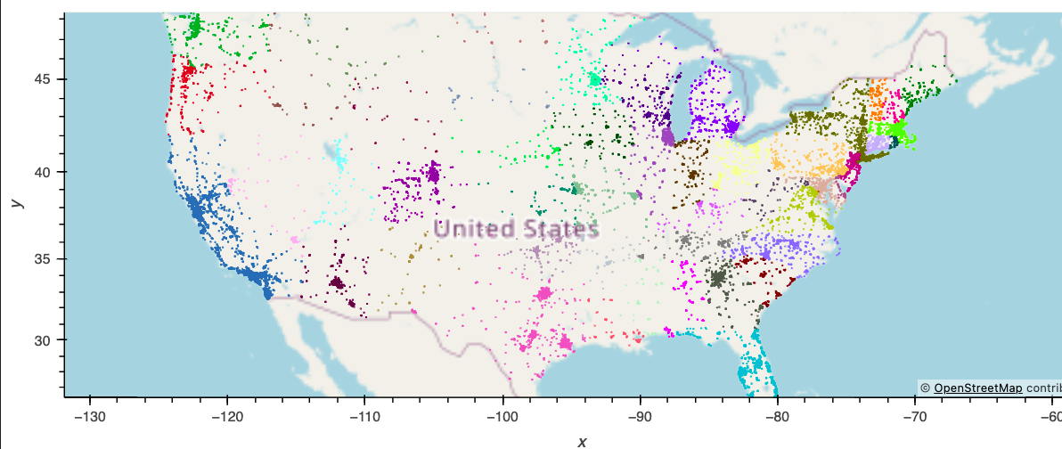
Commercial Applications:
Charging stations well established in major cities and coastal cities.
Charging limited in the Midwest and Southern States.

Slide 12
Commercial Applications:
The answer is No based on our findings. According to the dataset that we used for this check, within the 50 states, the saturation of EV charging stations tend to stay near the major cities off of the coast with a topographic location that isn't completely affected by a mountain range or flat land fields. There is also a lack of adoption in about 11 states where public charging station are less that 160 total with the worst instance being 40 chargers in Arkansas. The answer would be a “Yes" if the occupation had a route that could be used that also had multiple charging station laid out among the states that would be travelled through, but if the routes required travel into the Midwest or Mountainous areas, the amount of charging stations are not dispersed evenly among states with differing sizes and area to cover.

Slide 13
Affordability
Question 3: Cost comparison over a 5-year span for Tesla Model 3 and Toyota Corolla?

Slide 14
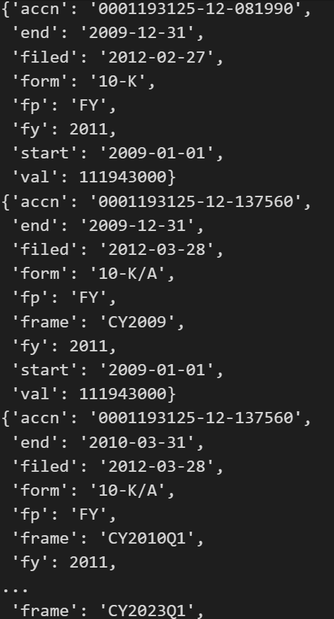
SEC Edgar API Dataset:

Slide 15
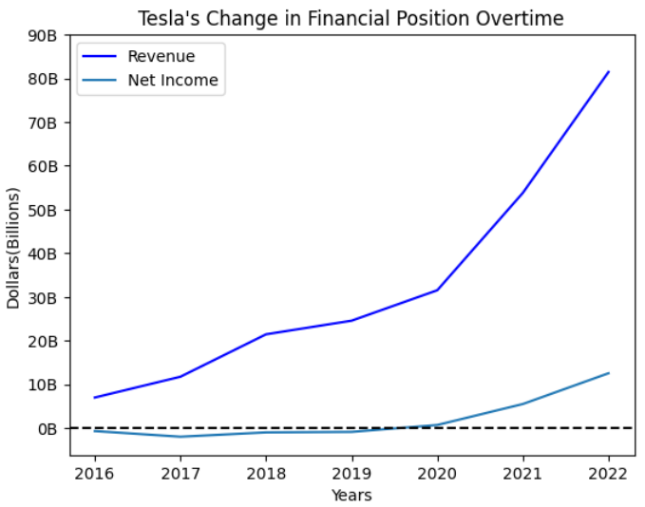
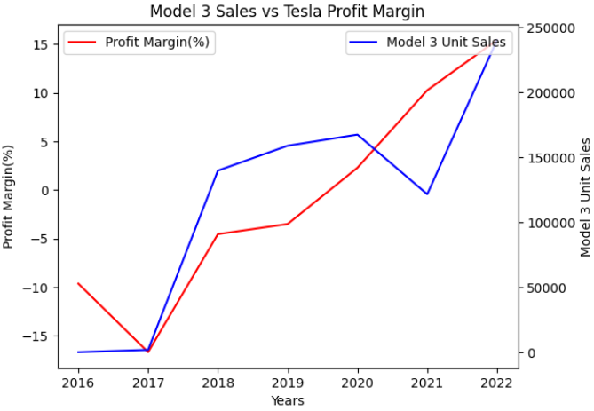
Affordability – tesla’s financial position over time

Slide 16
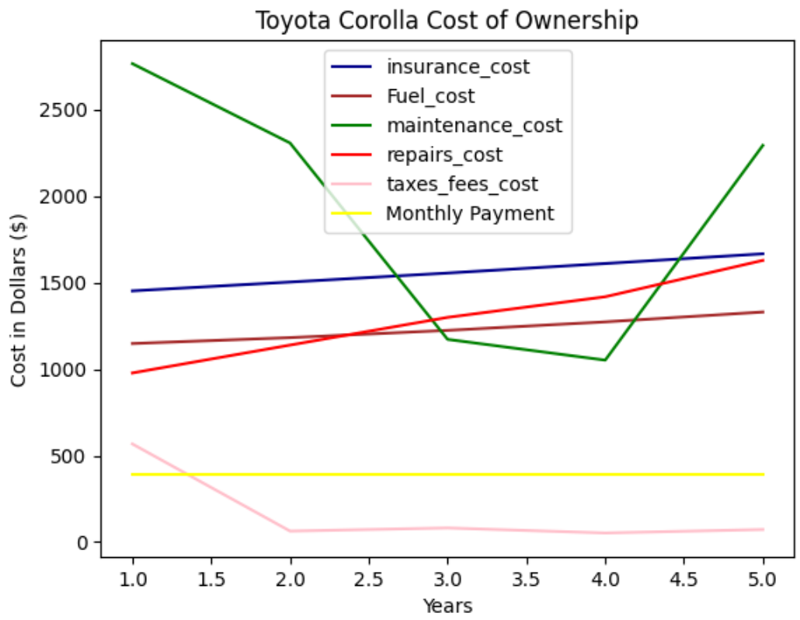
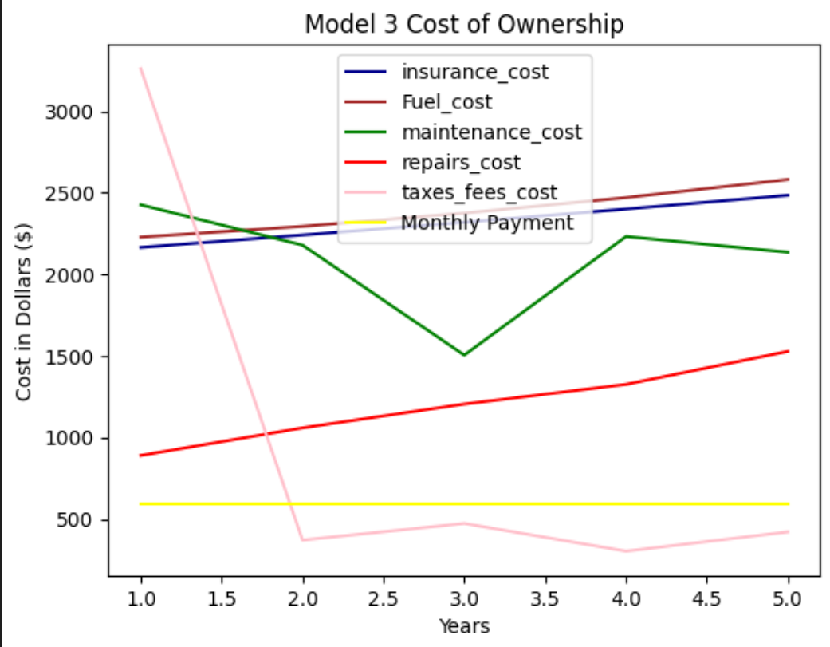
Affordability – cost of ownership
Cost of Ownership:
-Model 3 Total Cost of Ownership: 47,841, per month: 797.35 -Toyota Corolla Total Cost of Ownership: 32,770, per month: 546.17
-The Toyota Corolla is cheaper by 251.18 given the Vinaudit API data.

Slide 17
Questions:

